Slide 1
AOTF and ILS
Geronimo Villanueva and Giuliano Liuzzi
NASA Goddard Space Flight Center
October 2018

Slide 2
AOTF

Slide 3
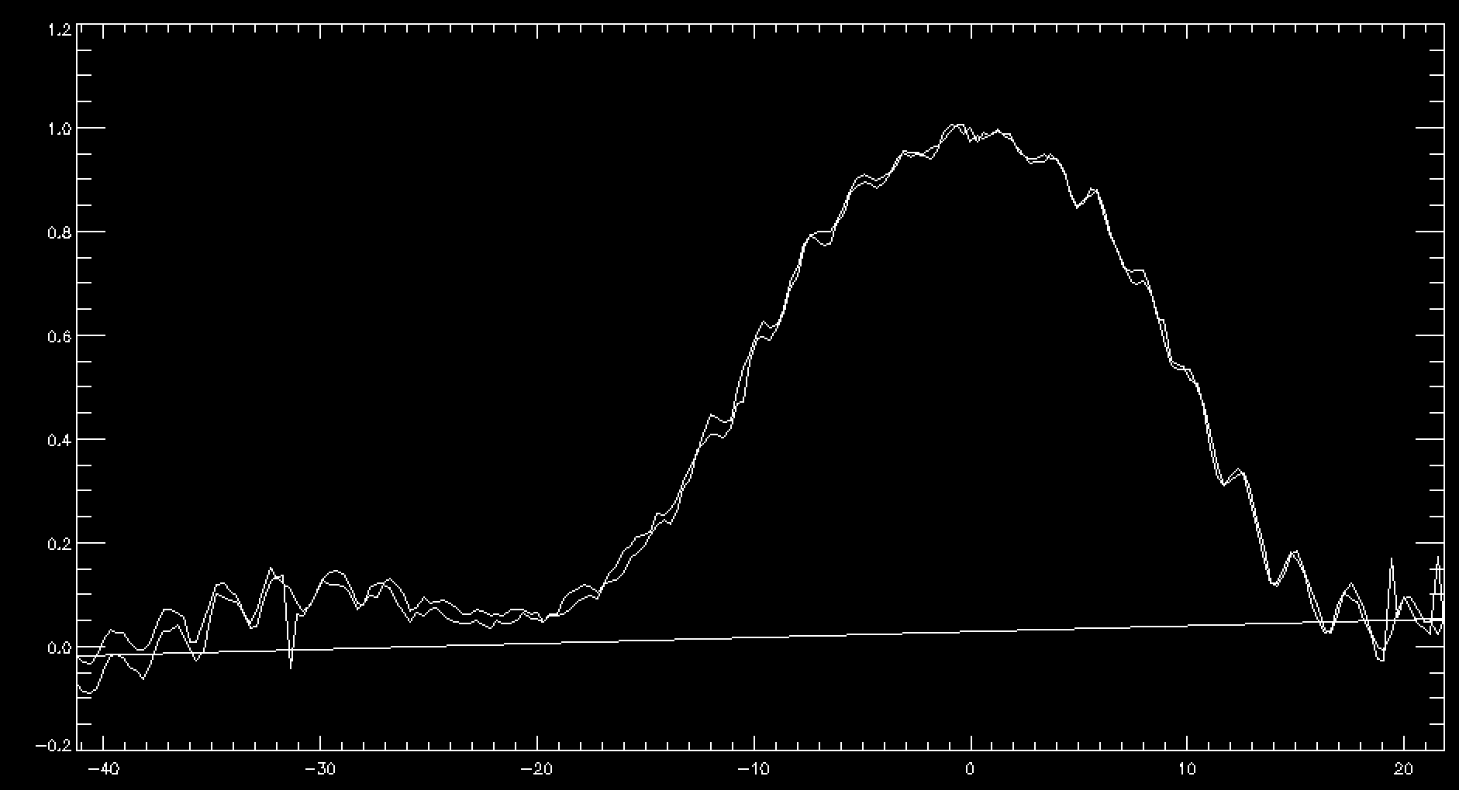
2837.83 cm⁻¹

Slide 4
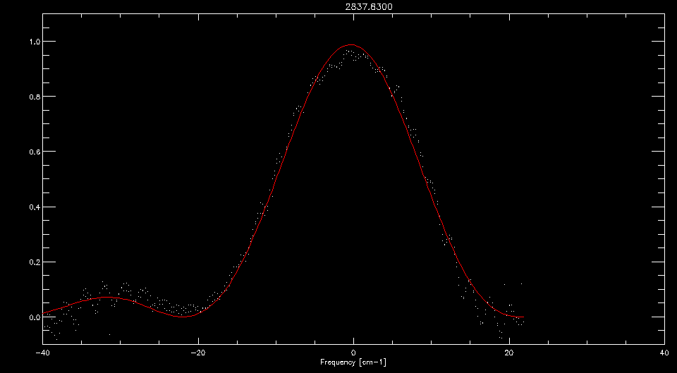

Slide 5
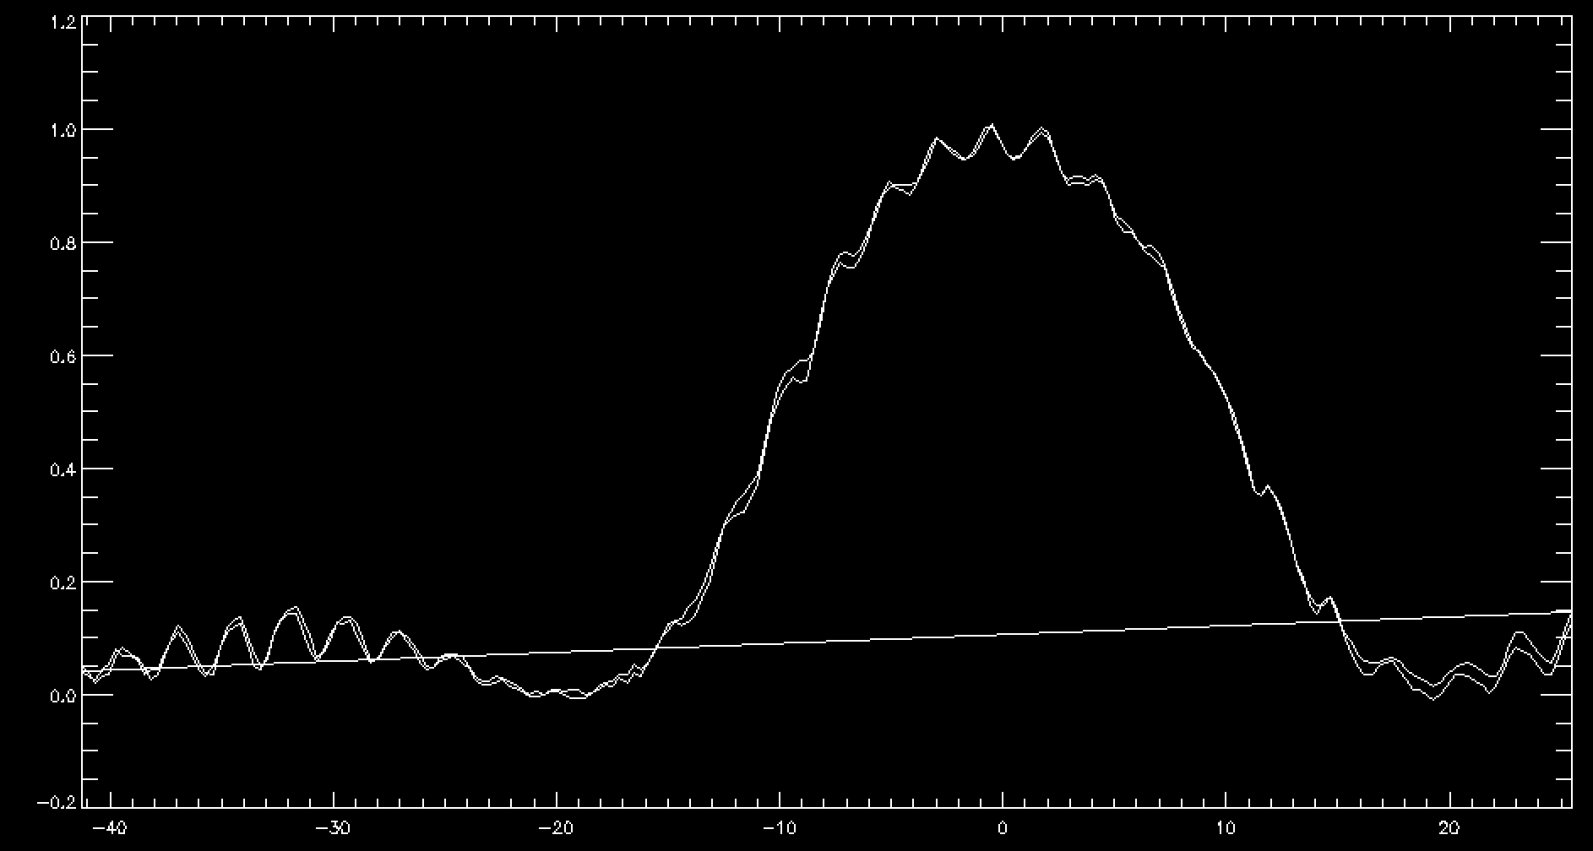
3172.86 cm⁻¹

Slide 6
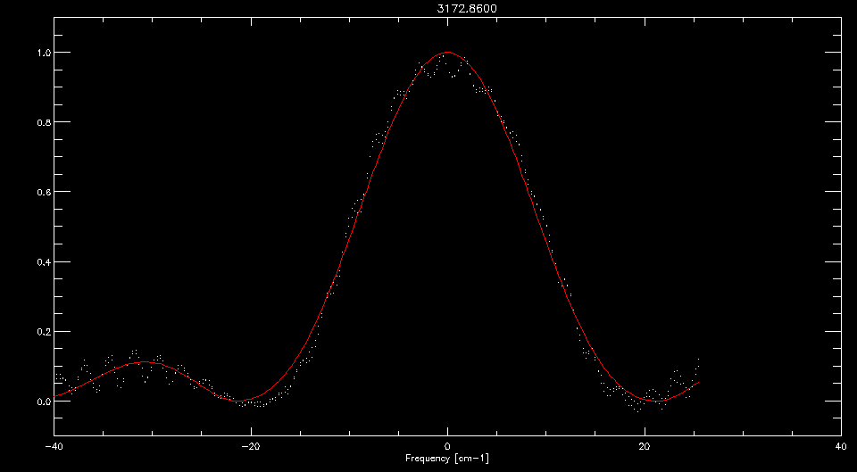

Slide 7
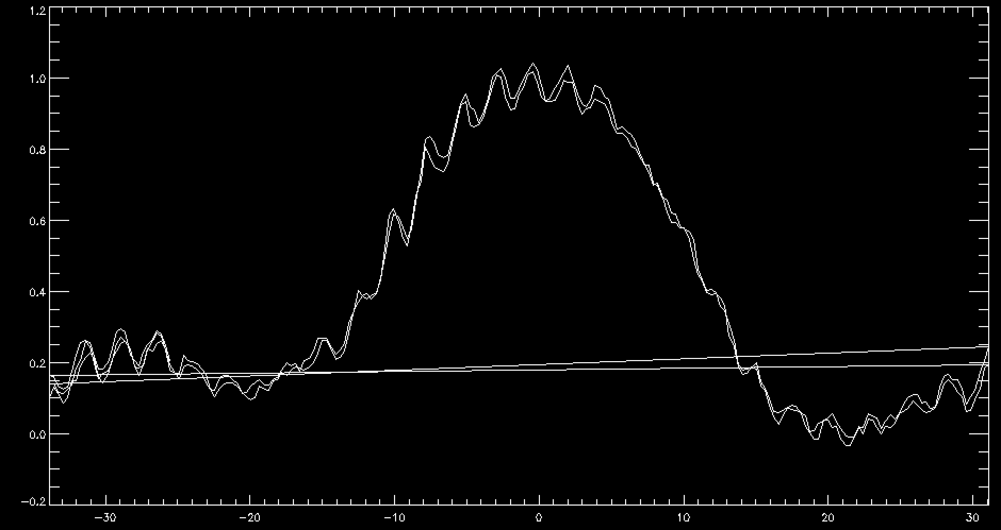
3289.57 cm⁻¹

Slide 8
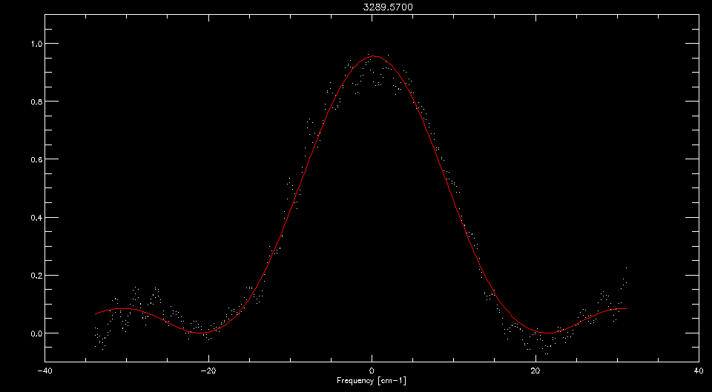

Slide 9
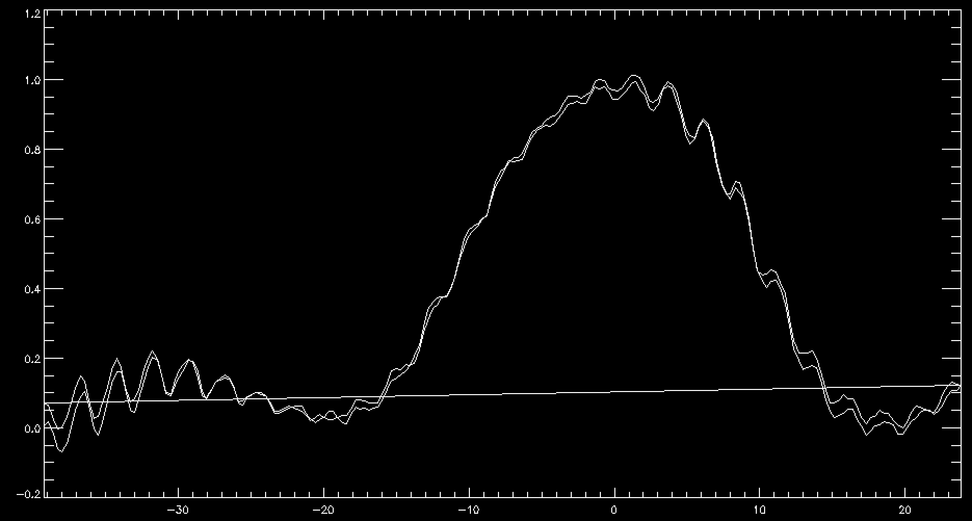
3650.93 cm⁻¹

Slide 10
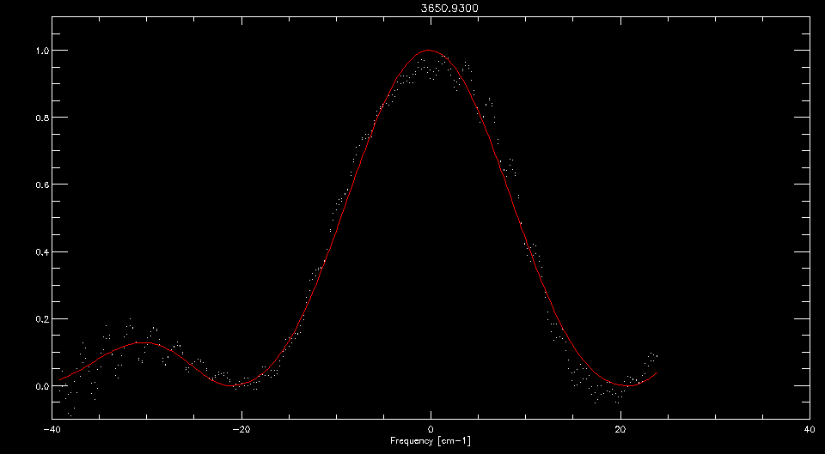

Slide 11
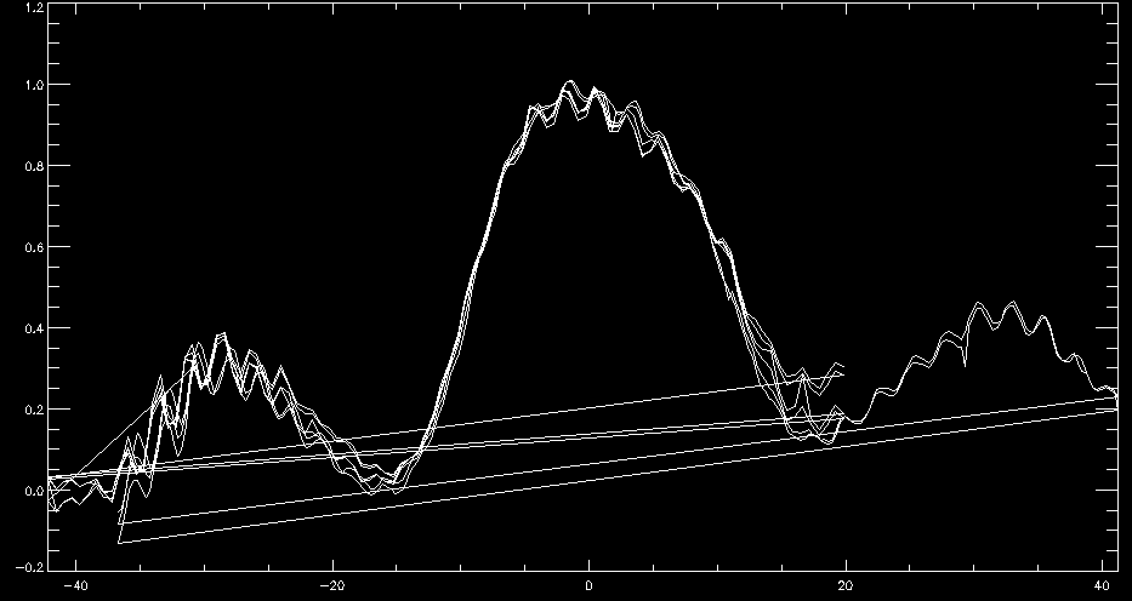
4383.21 cm⁻¹

Slide 12
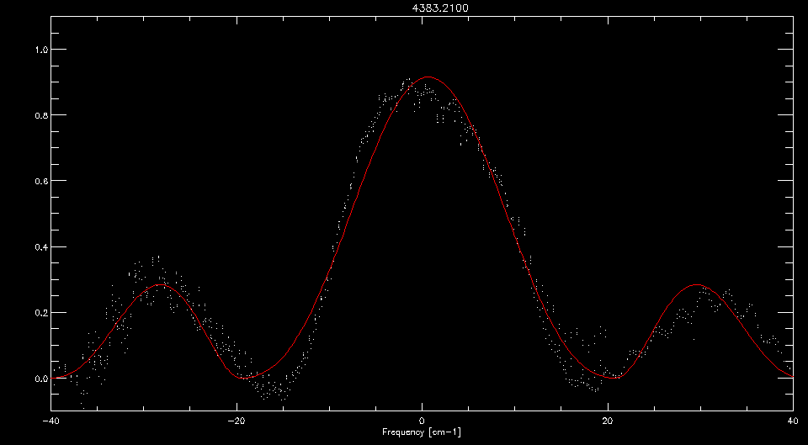

Slide 13
Blaze

Slide 14
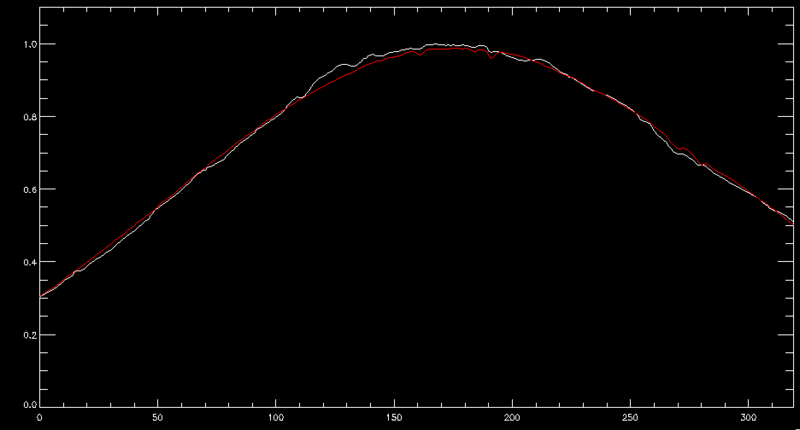
Order 119

Slide 15
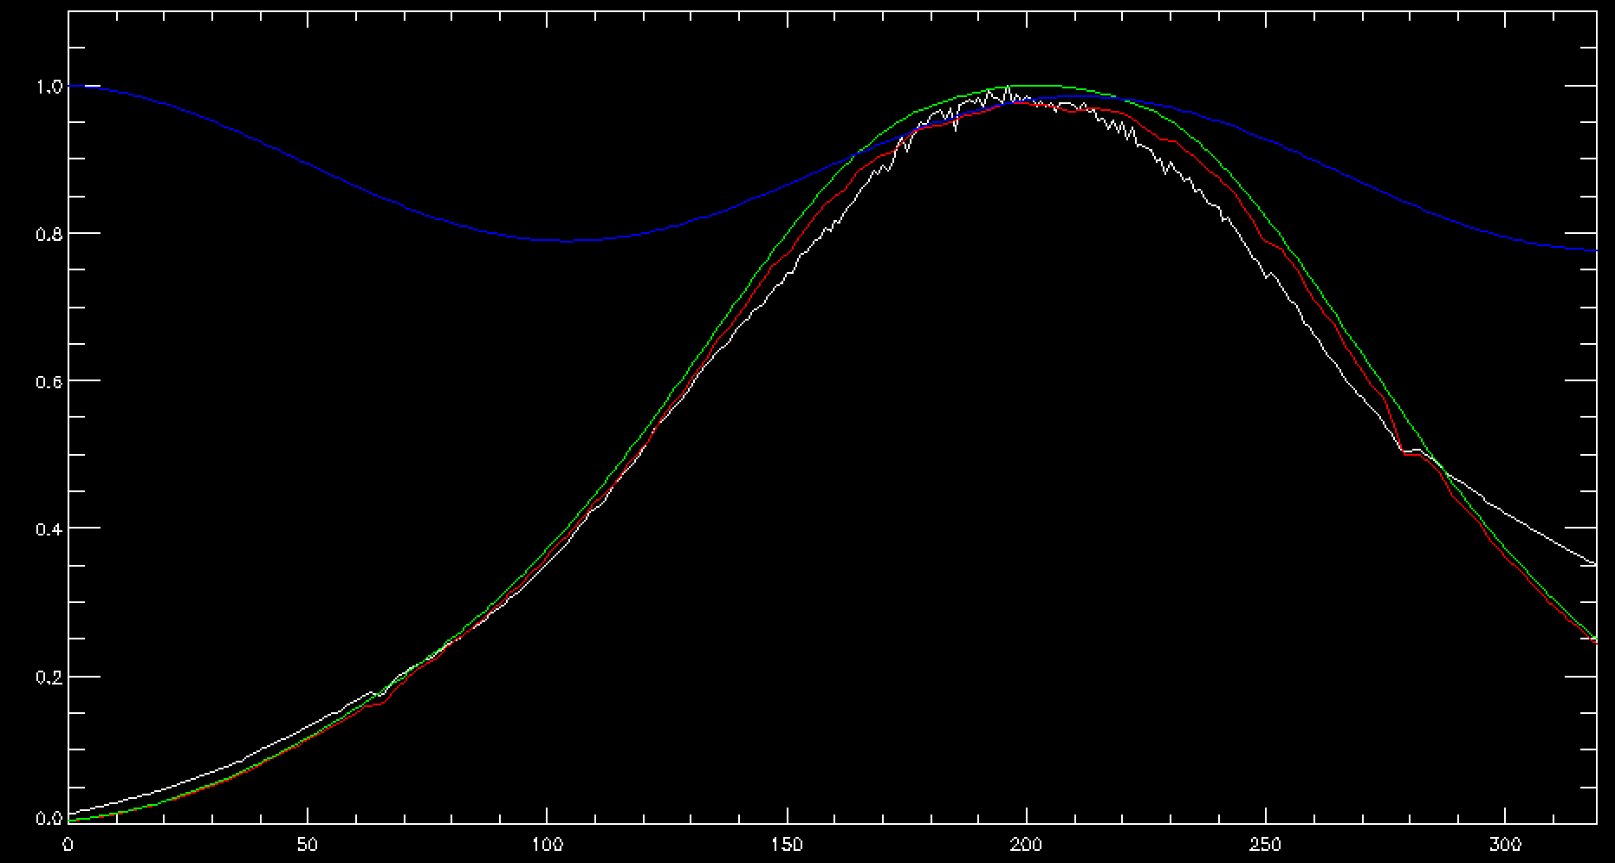
Order 189

Slide 16
Instrument
Response
Solution

Slide 17
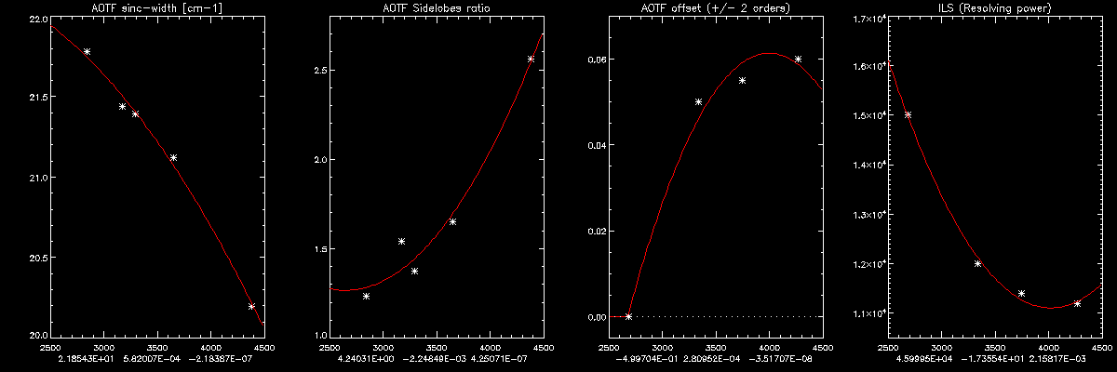

Slide 18
Application
To the data

Slide 19
