Slide 1
Characterization of the AOTF function and resolving power of the NOMAD/SO channel
Geronimo Villanueva, NASA-GSFC
May/4 2020

Slide 2
Resolving power
We investigate the response of the instrument across the pixels by performing a convolution between the observed data and a synthetic fully resolved spectrum (RP>2E5).
The convolution between the fully data and the fully-resolved model is effectively a form or auto-correlation, returning the kernel of the instrument. Due to the periodicity of the CO₂ lines, “aliases” appear at 2 times the rotational constant.
We use a local convolution (+/- 25% of the pixels) at each pixel to perform the analysis.

Slide 3
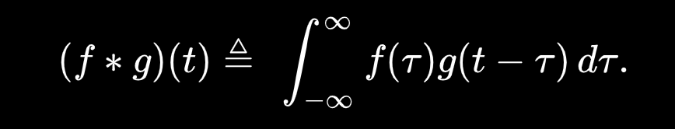
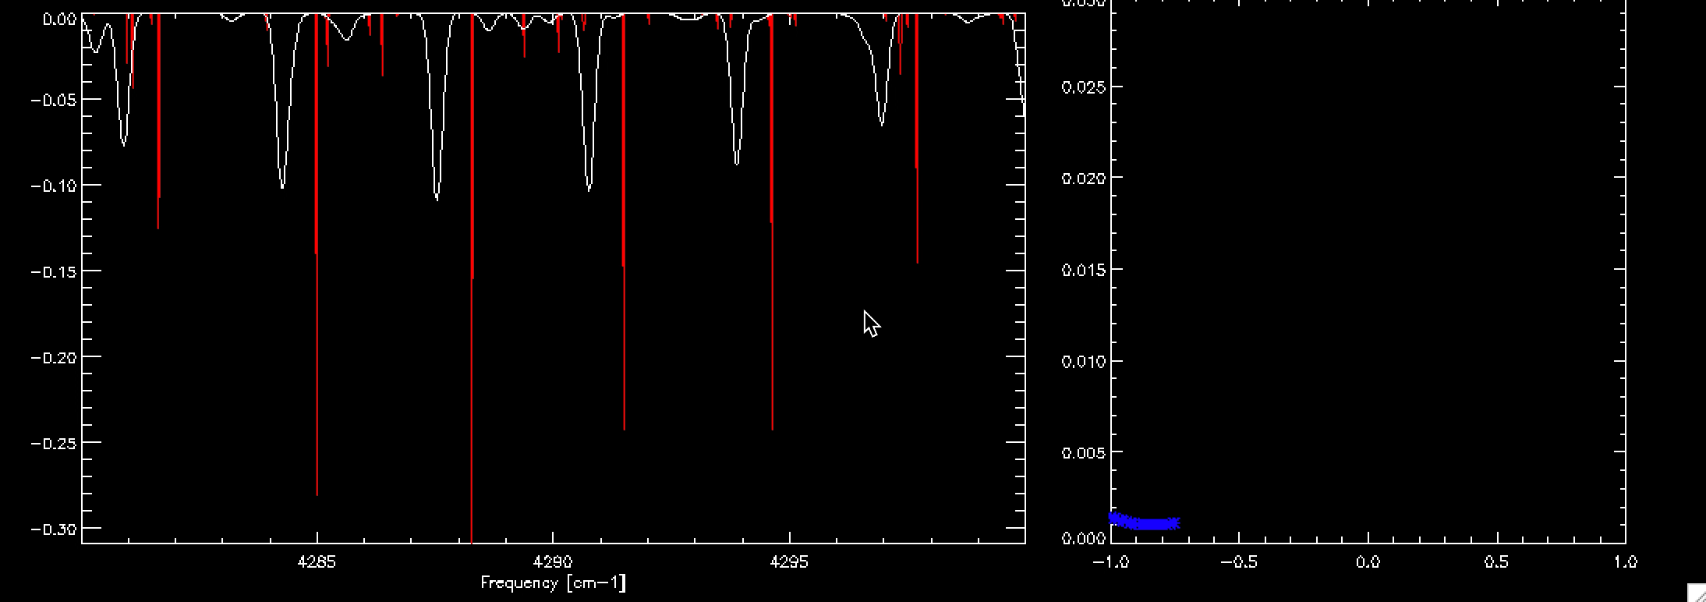

Slide 4
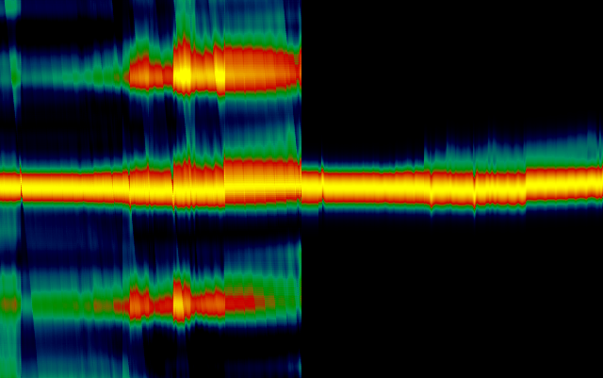
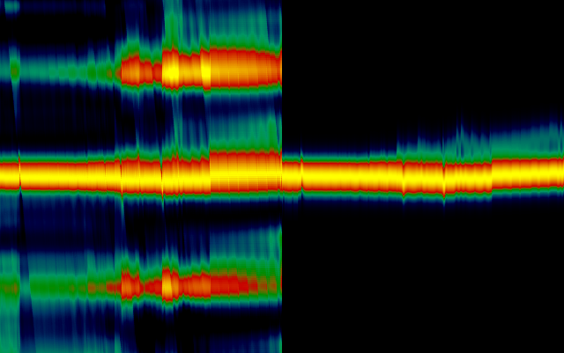
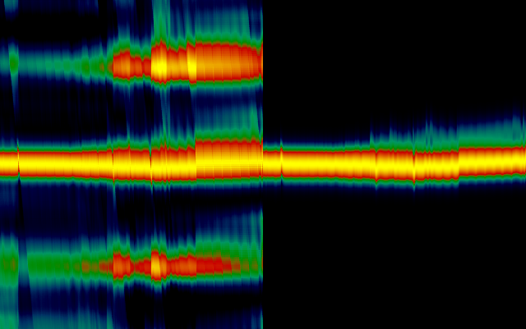
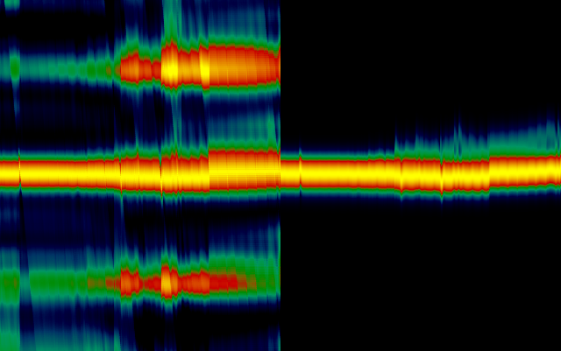
Order 119
Data
Model
Data
Model
Kernel shape
Kernel shape
Bin0
Bin2
Pixels
Pixels
Kernel shape
Kernel shape
Bin1
Bin3

Slide 5
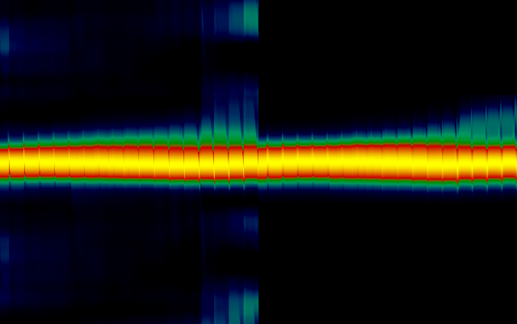
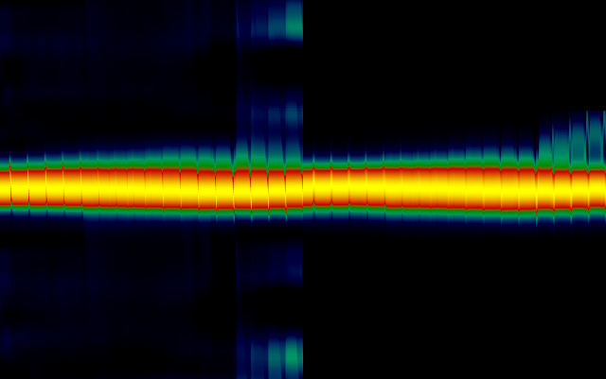
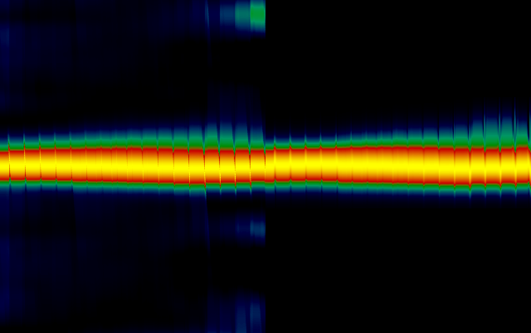
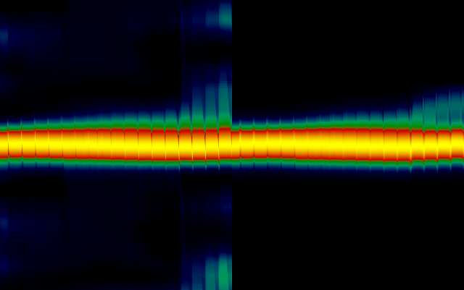
Order 149
Data
Model
Data
Model
Kernel shape
Kernel shape
Bin0
Bin2
Pixels
Pixels
Kernel shape
Kernel shape
Bin1
Bin3

Slide 6
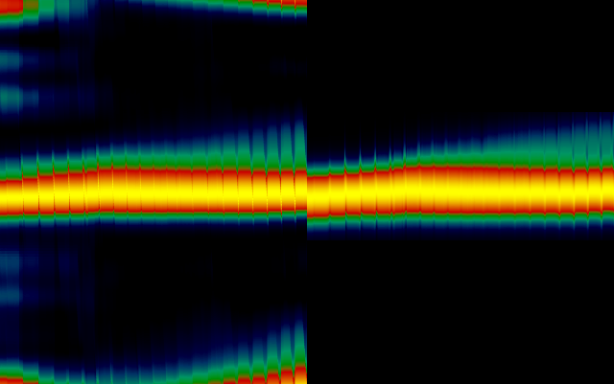
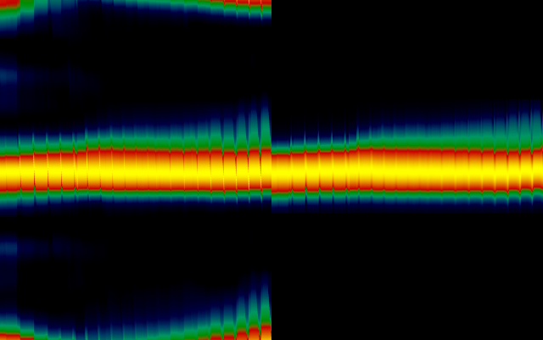
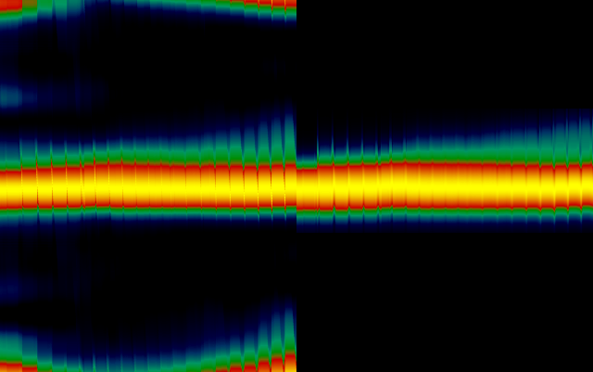
Order 165
Data
Model
Data
Model
Kernel shape
Kernel shape
Bin0
Bin2
Pixels
Pixels
Kernel shape
Kernel shape
Bin1
Bin3

Slide 7
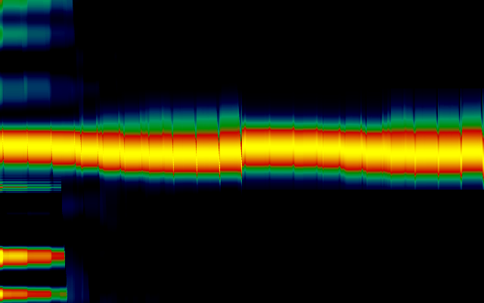
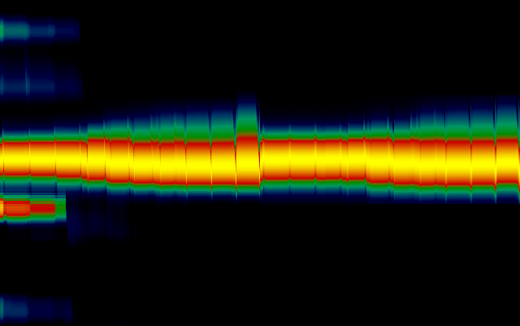
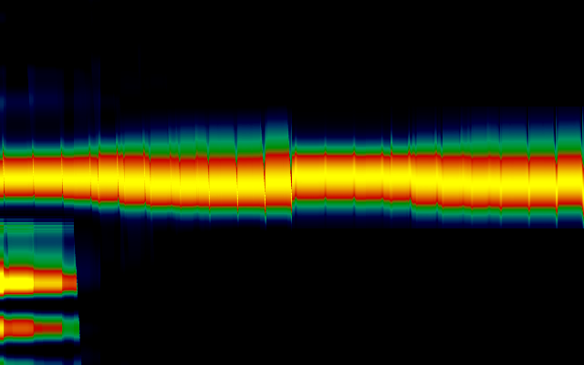
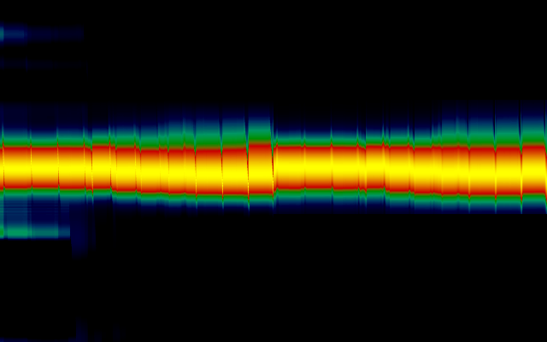
Order 190
Data
Model
Data
Model
Kernel shape
Kernel shape
Bin0
Bin2
Pixels
Pixels
Kernel shape
Kernel shape
Bin1
Bin3

Slide 8
Not an ILS issue, but a refracted “ghost”
I investigated a myriad of possible combinations and optical processes that could lead to this.
The existence of a “ghost” reflection is the most favored, since it can generalized across all orders, and would mean a crystal broke and there is a refracted ghost.
The “ghost” has an intensity of ~25% of the main signal, and it displaces up to 0.3 cm-1 across the detector.
We should NOT be affecting the ILS, but adding the “ghost” signal. This is what seems to be happening inside the instrument.
There are slight differences between bins but they can be generally well modeled with a single solution for all bins

Slide 9
The ILS + ghost “recipe”
Convolve the model to a resolving power of 20,000 –
  m(f) = h(f) * kernel(20,000), where h is the fully resolved model.
Compute a frequency displaced “ghost” image with the following dispersion [cm-1] at pixel ‘p’, where f0 is the center freq [cm-1].
df(p) = (-0.031606901 + 0.0018259633*p -2.4333526e-06*p*p)*(f0/3700)
The ghost model is m_ghost(f) = m(f + df[p])
The total signal
  m_new(f) = (m(f) + 0.25*m_ghost(f))/1.25
  (m(f) + 0.25*m(f+df[p]))/1.25

Slide 10
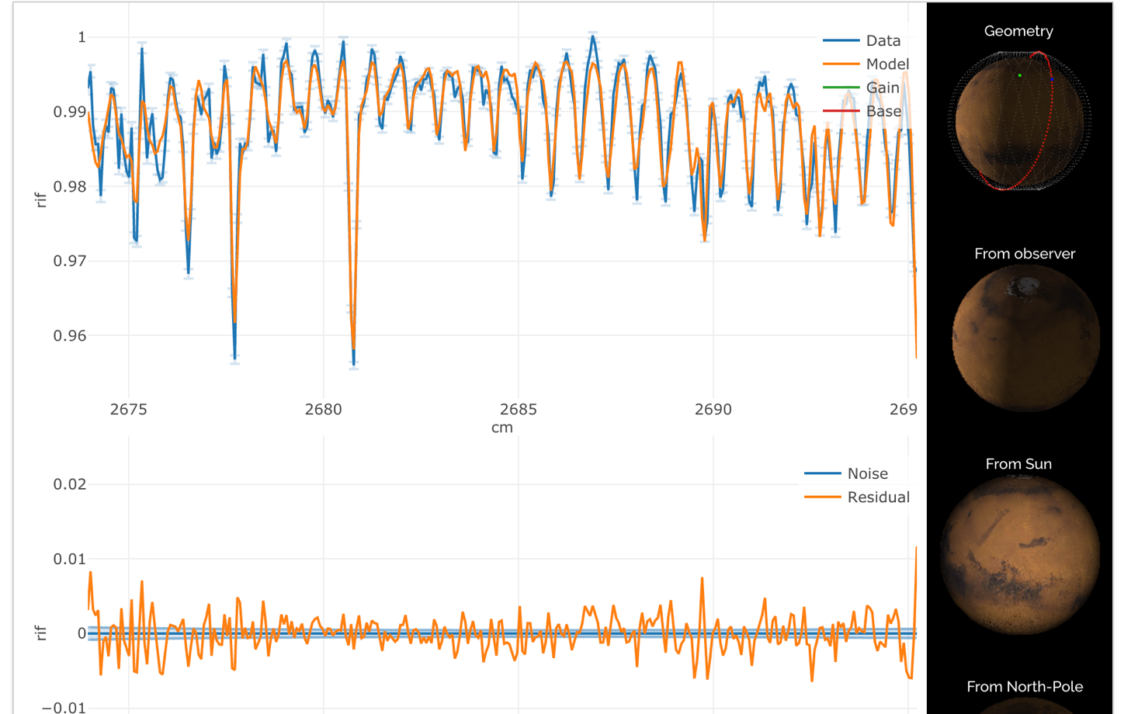
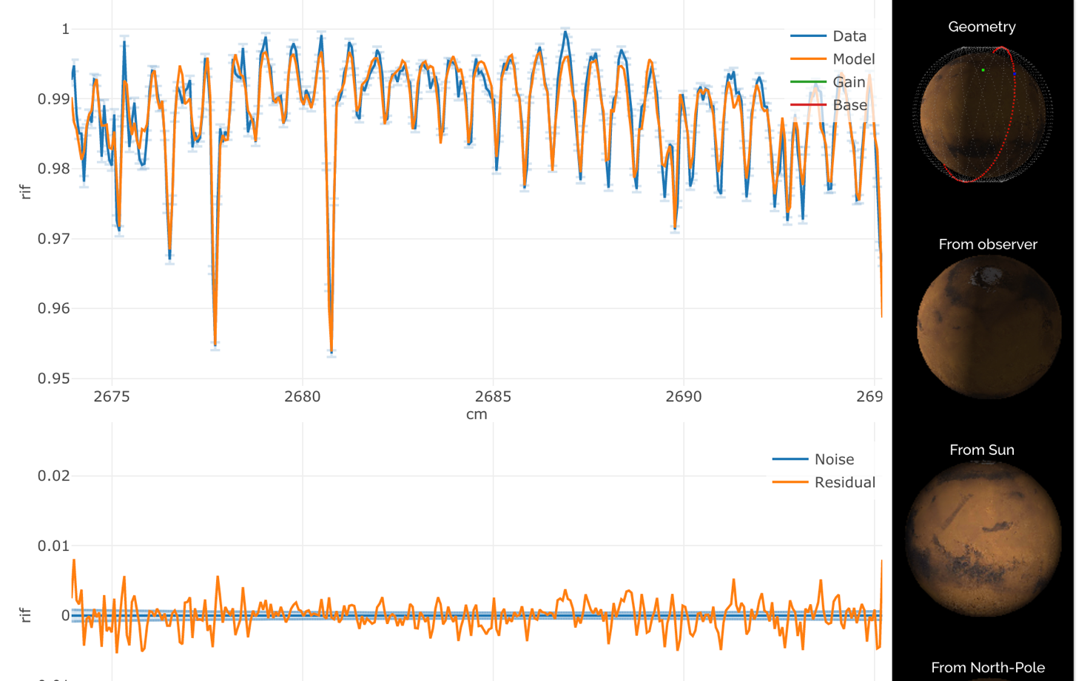
Example order 119
Original
New

Slide 11
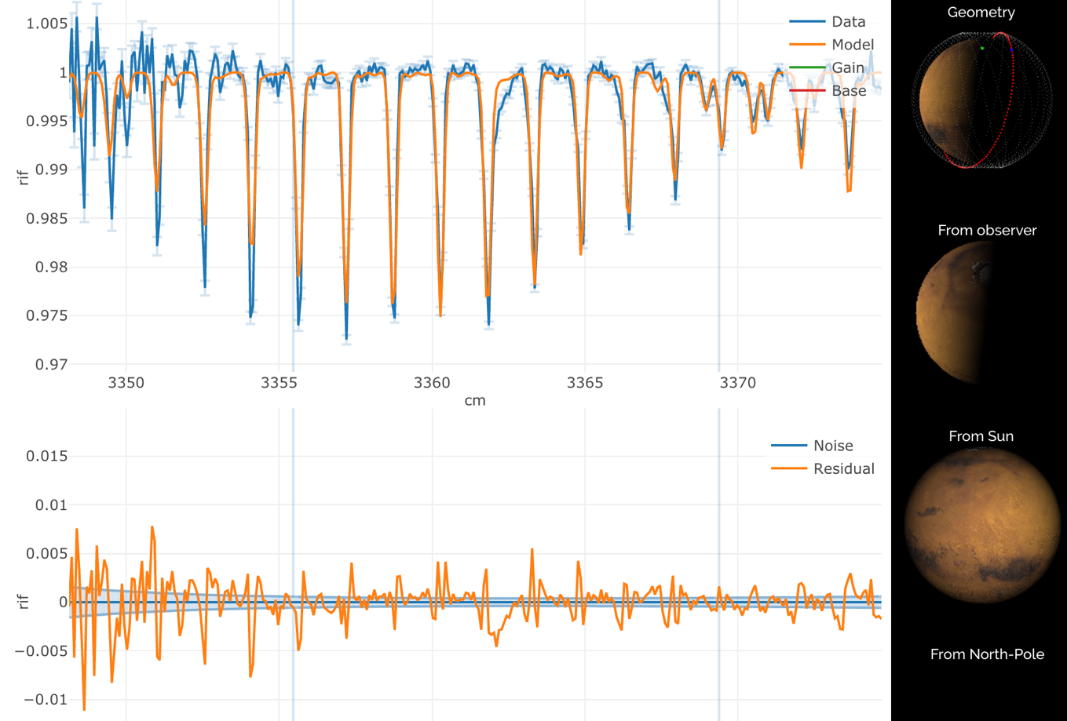
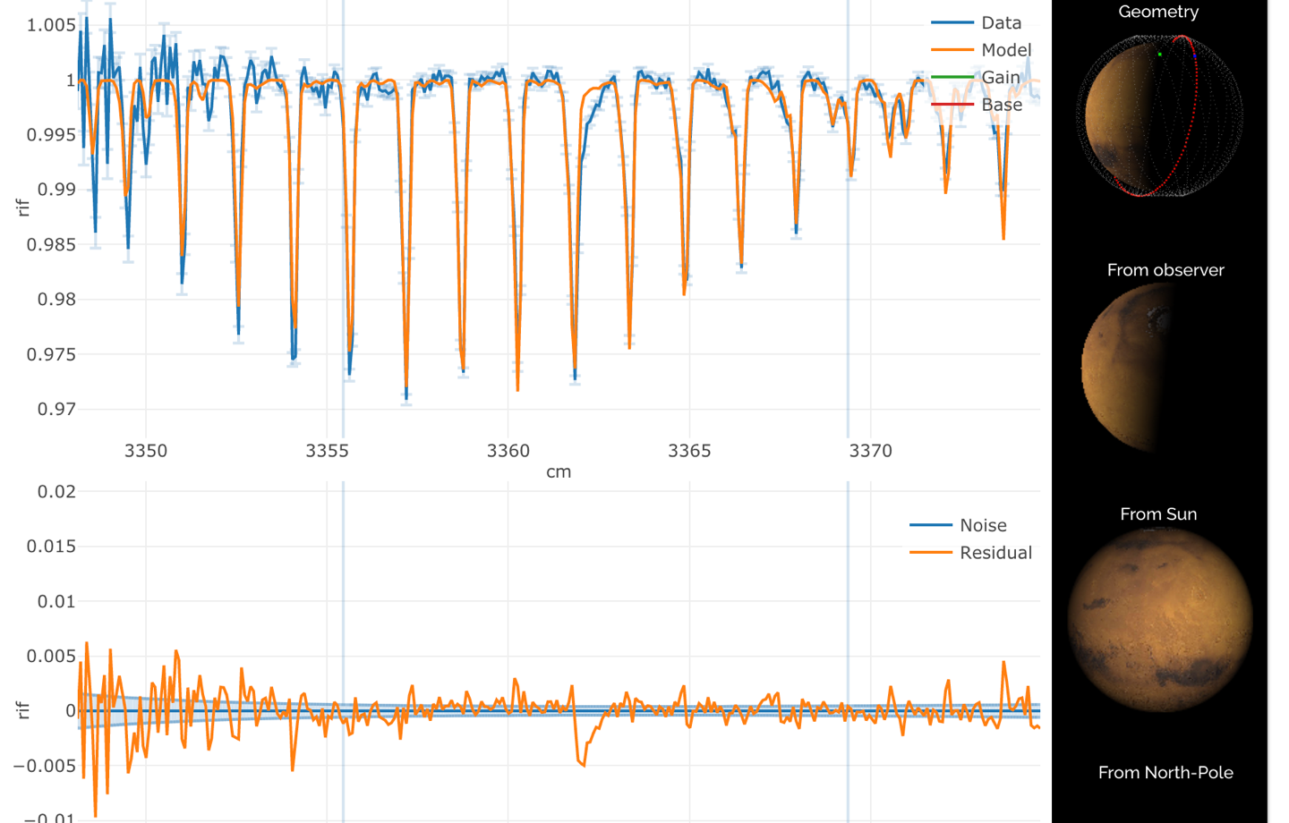
Example order 149
Original
New
AOTF issue

Slide 12
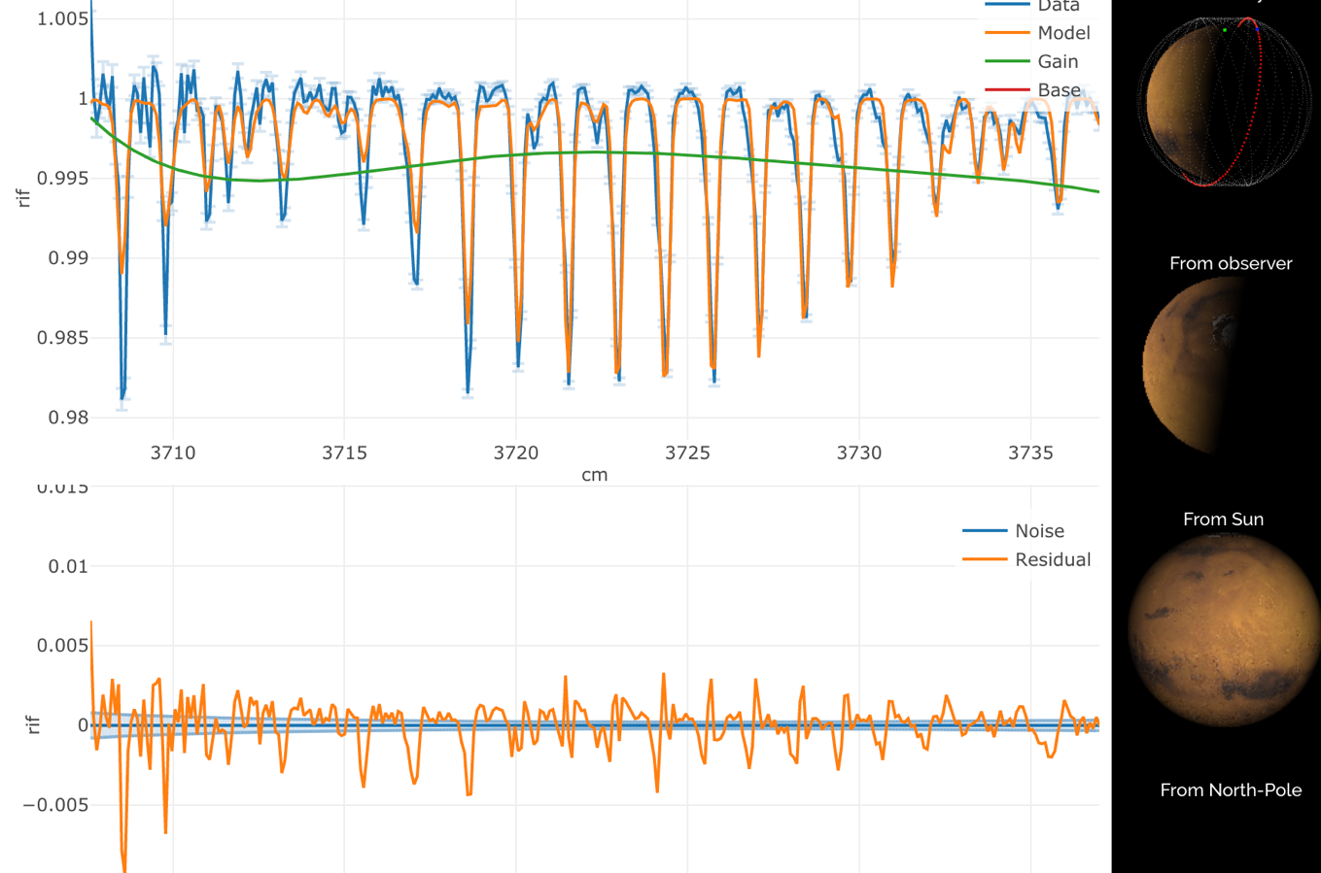
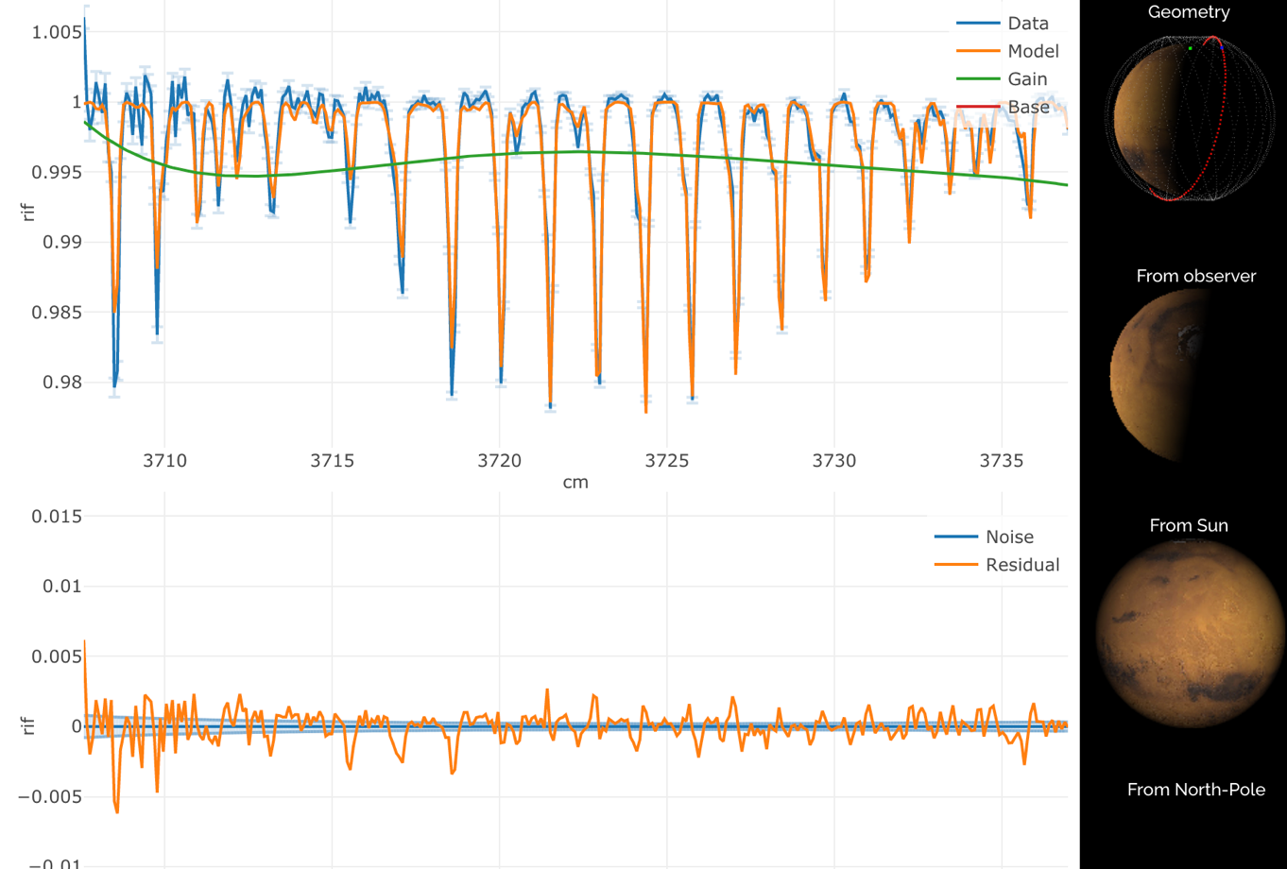
Example order 165
Original
New

Slide 13
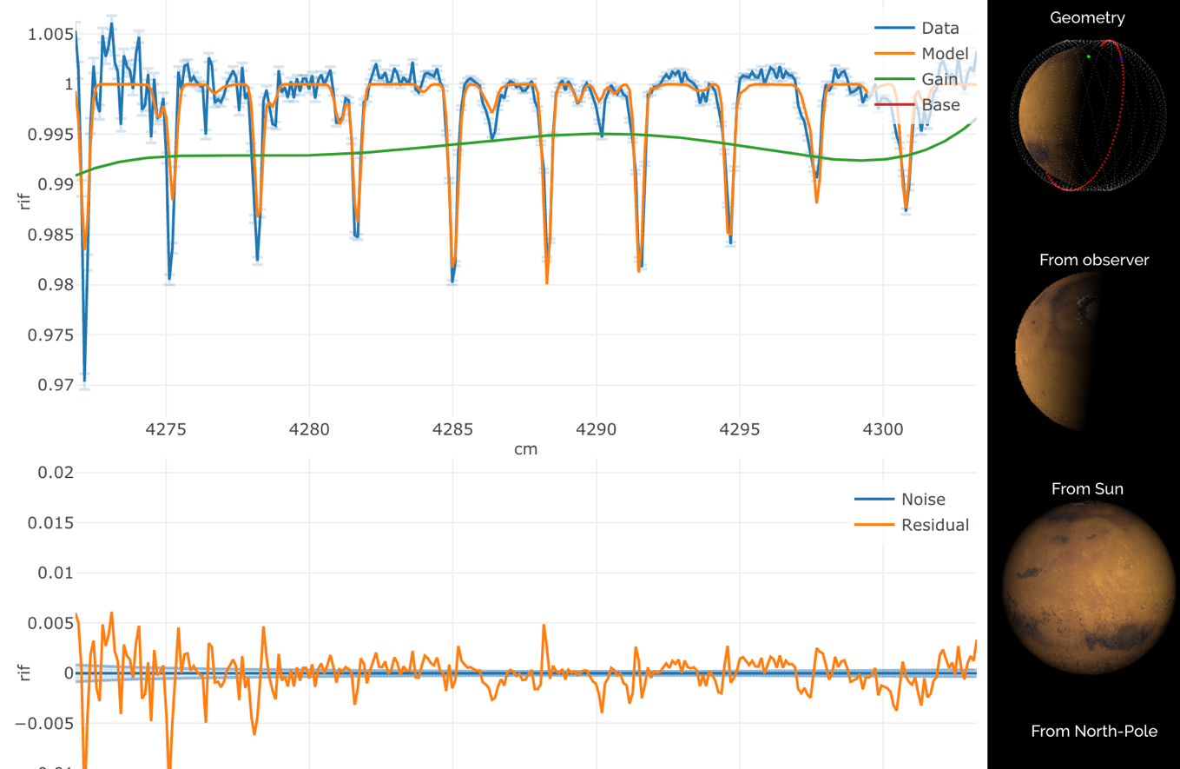
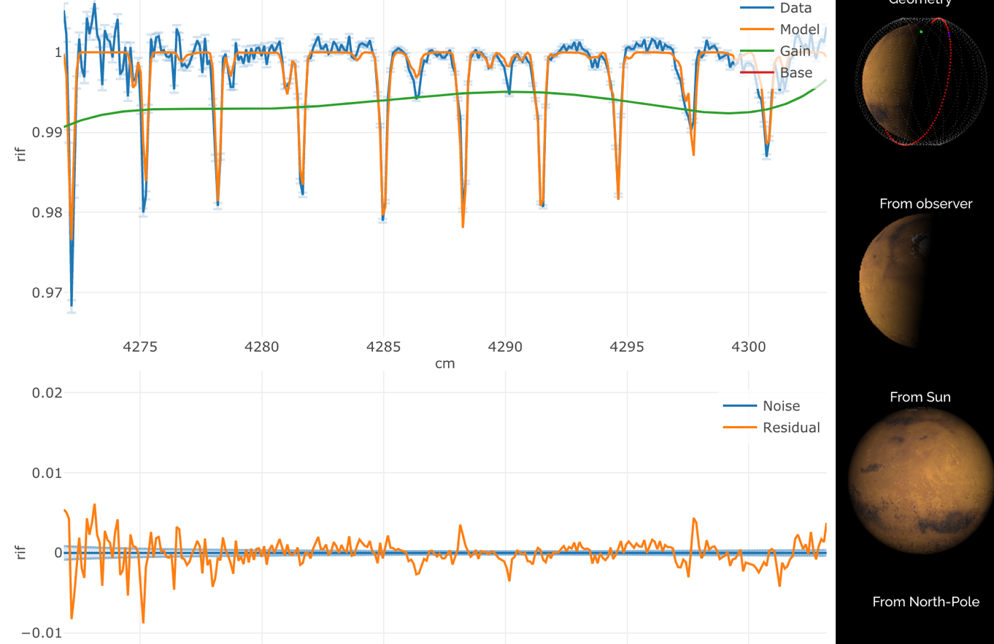
Example order 190
Original
New

Slide 14
The ILS + ghost “recipe”
The initial results look promising. By generalizing to all “orders” and “bins” some quality/match is lost, but the “recipe” does improve the results compared to a single gaussian.
The fact that the displacement of the “ghost” is proportional to frequency suggest a refraction + reflection process. Perhaps a lens cracked?
Importantly, my recommendation is not to use “variable” ILS, but to add a displace “ghost” image.
We need to start refining the “recipe” coefficients and to test on other datasets.

