Slide 1
AOTF Characterization
ExoMars/TGO/NOMAD
Solar Occultation (SO) channel
Geronimo Villanueva
Giuliano Liuzzi
NASA/GSFC – March/2021

Slide 2
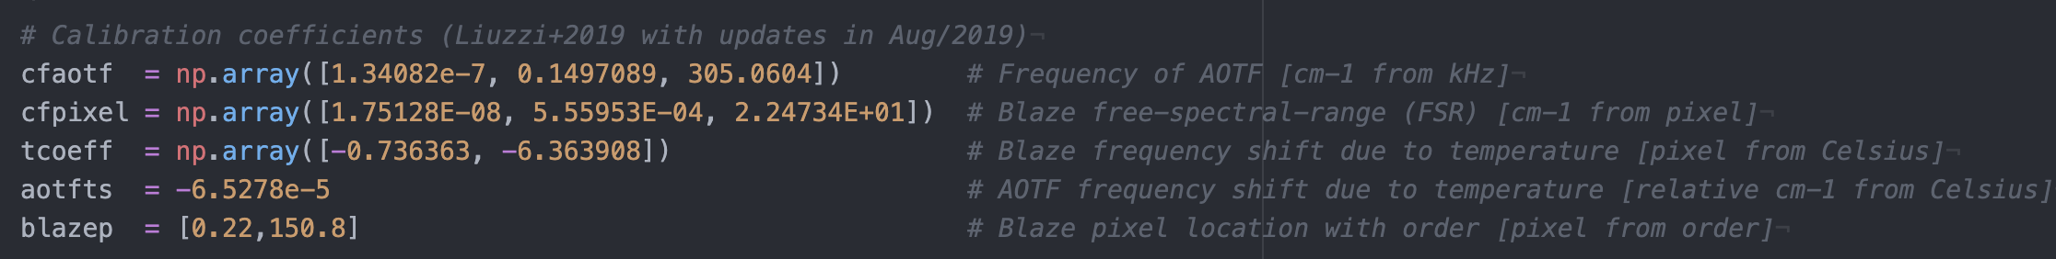
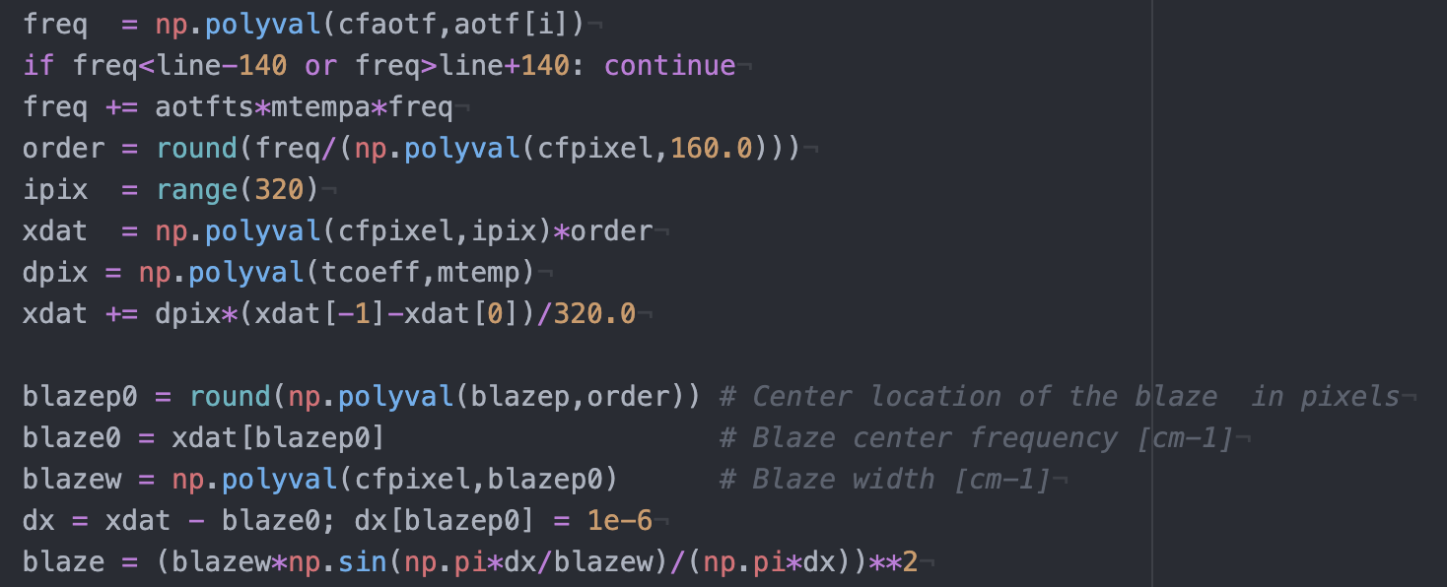
Base calibration parameters

Slide 3
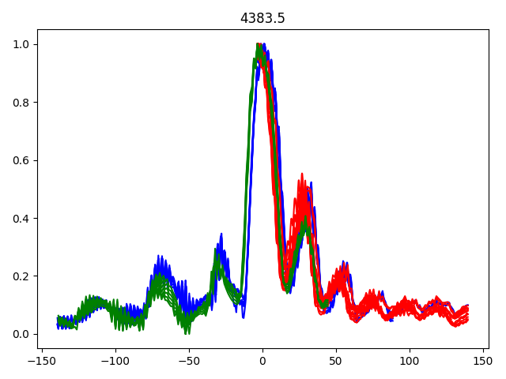
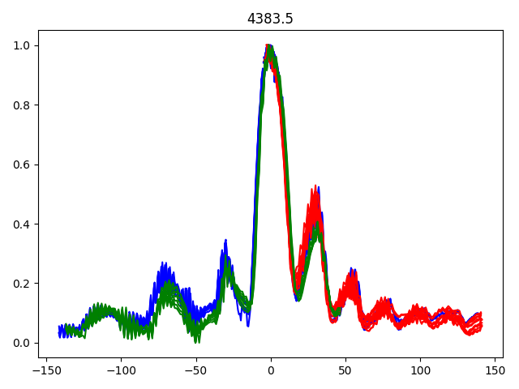
Line area of solar line at 4383.5 cm⁻¹ (Mg) vs. AOTF frequency [cm⁻¹]
Without temperature correction
With temperature correction
2018, 2019, 2020
2018, 2019, 2020

Slide 4
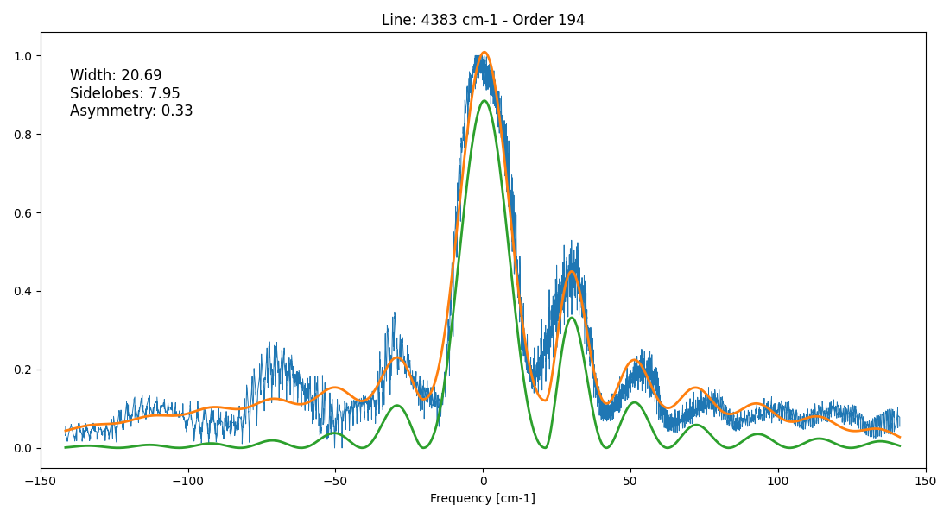
AOTF model

Slide 5
Contaminants and multiple sincs
The AOTF profile may be contaminated with solar lines from other orders.
How this affect the profile would appear intractable, but due to the AOTF and grating system, the contaminations only occur for lines exactly at distances of blaze times order.
These contaminations would appear as a shifted sinc at that position, and can be easily identified and removed.
These are not part of the AOTF transfer function - They are simply representations from another line!
These contaminant sincs are actually very useful for further refining the asymmetry and shape of the AOTF.

Slide 6

AOTF model

Slide 7

AOTF model

Slide 8
Analysis of several lines across the SO spectral range

Slide 9
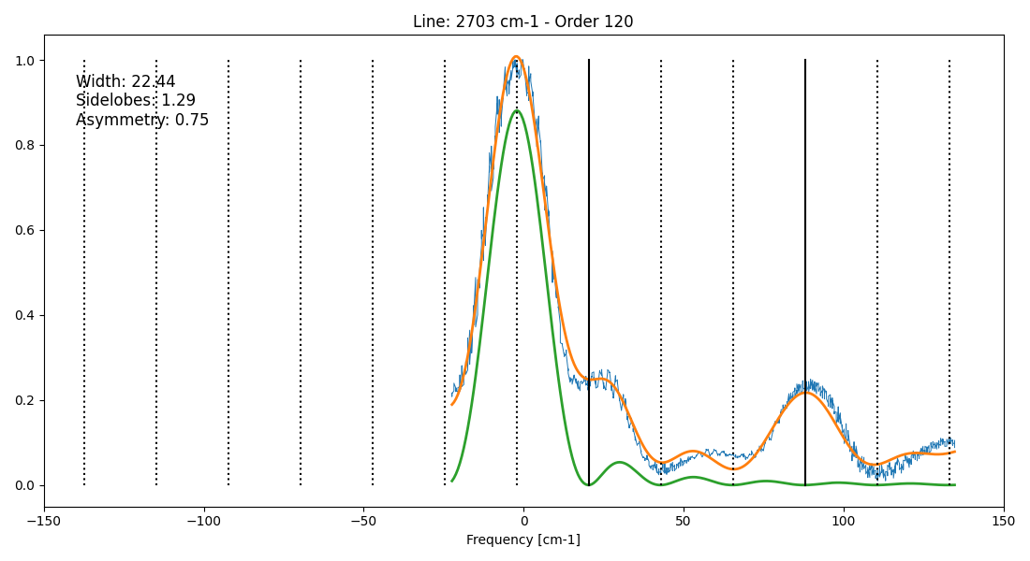

Slide 10
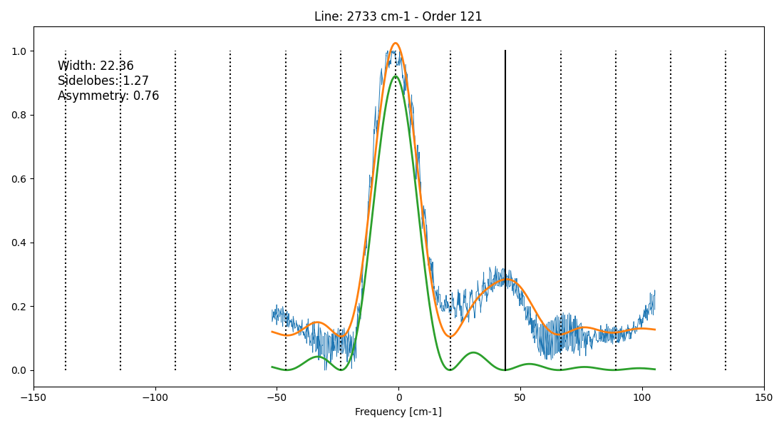

Slide 11
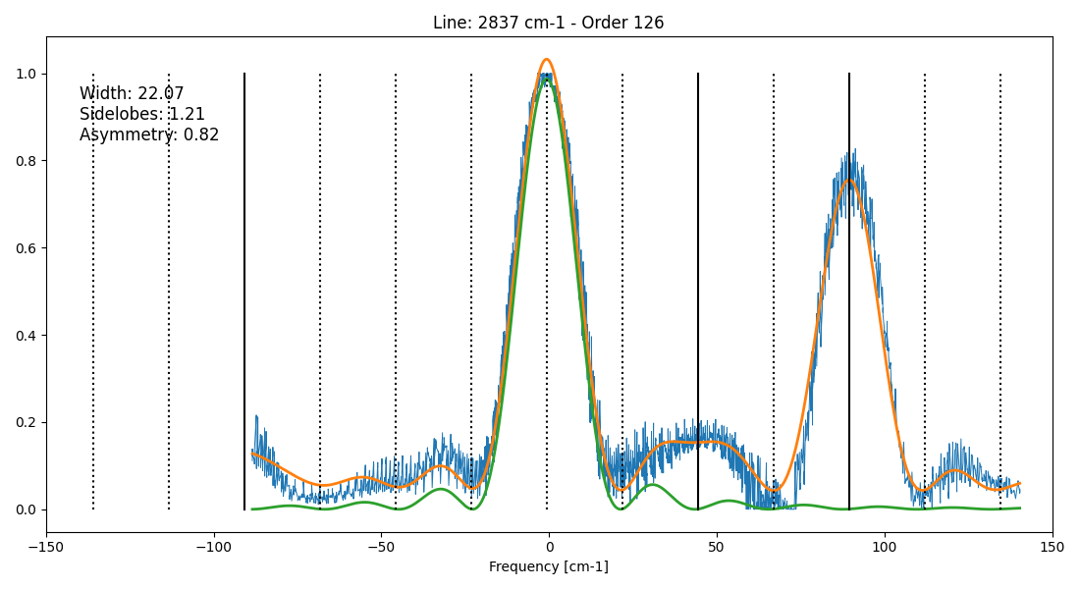

Slide 12
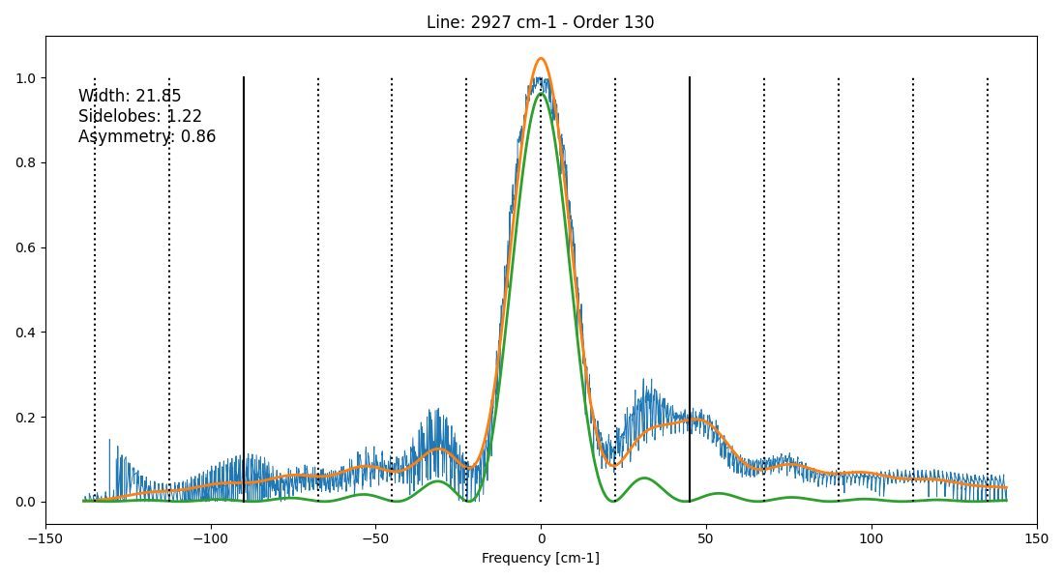

Slide 13
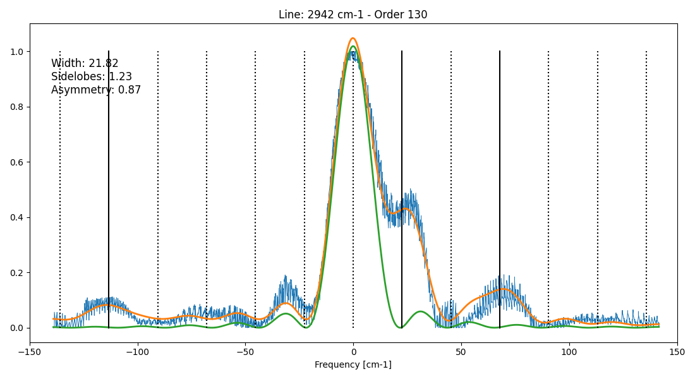

Slide 14
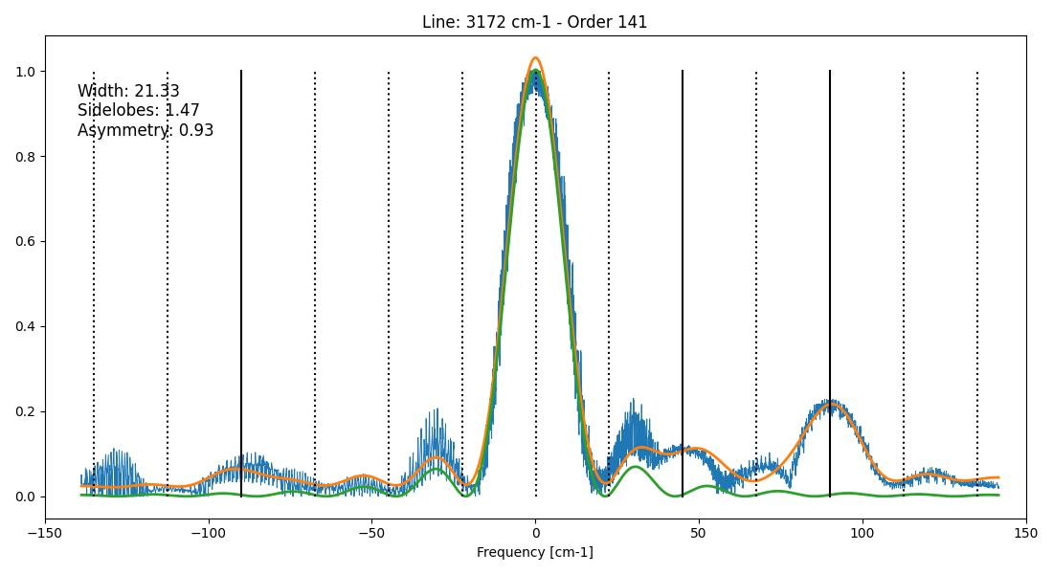

Slide 15
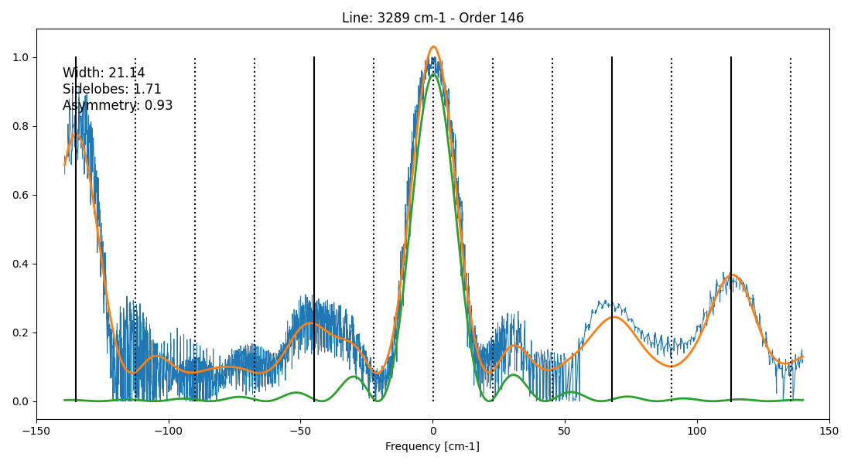

Slide 16
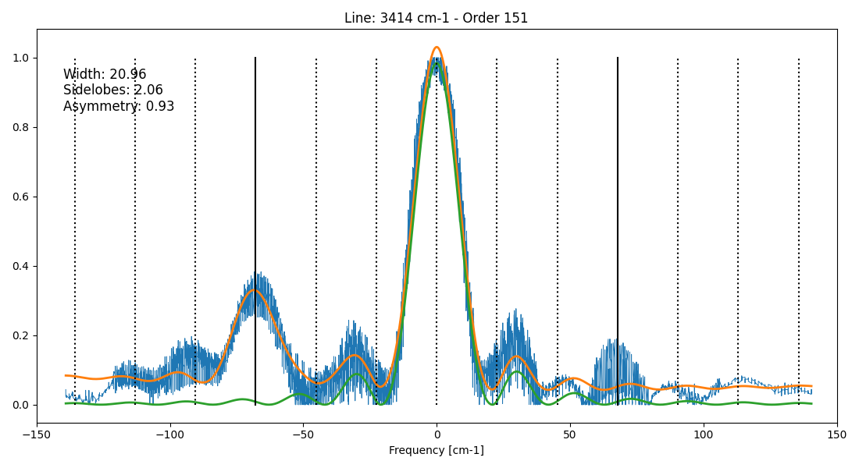

Slide 17
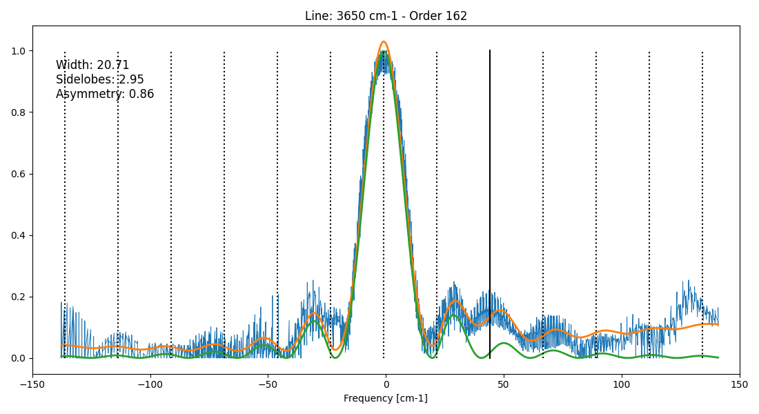

Slide 18
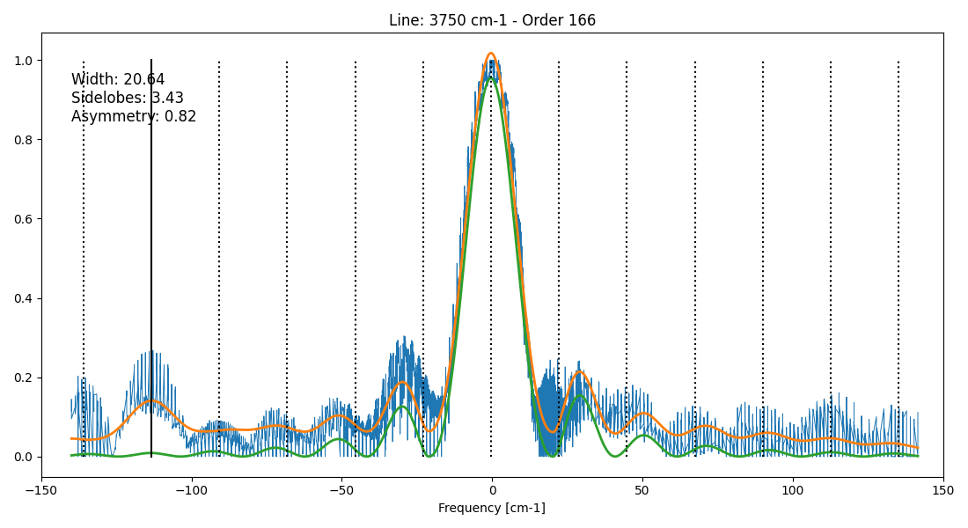

Slide 19
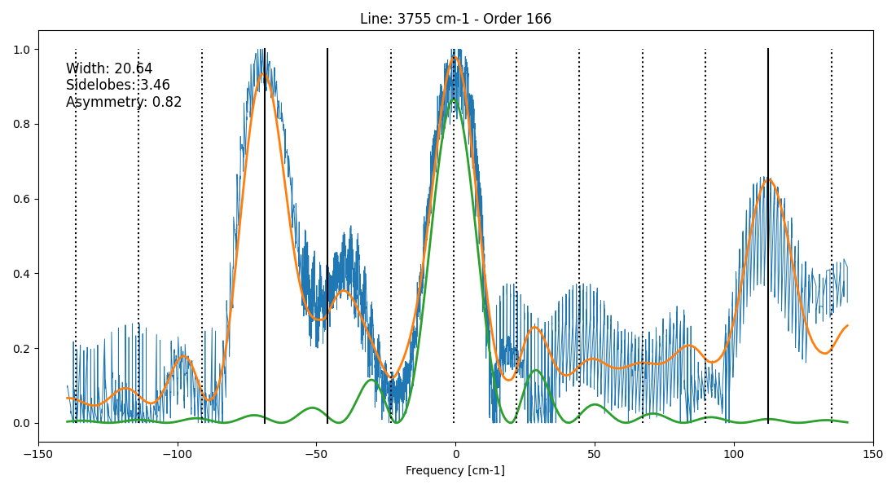

Slide 20
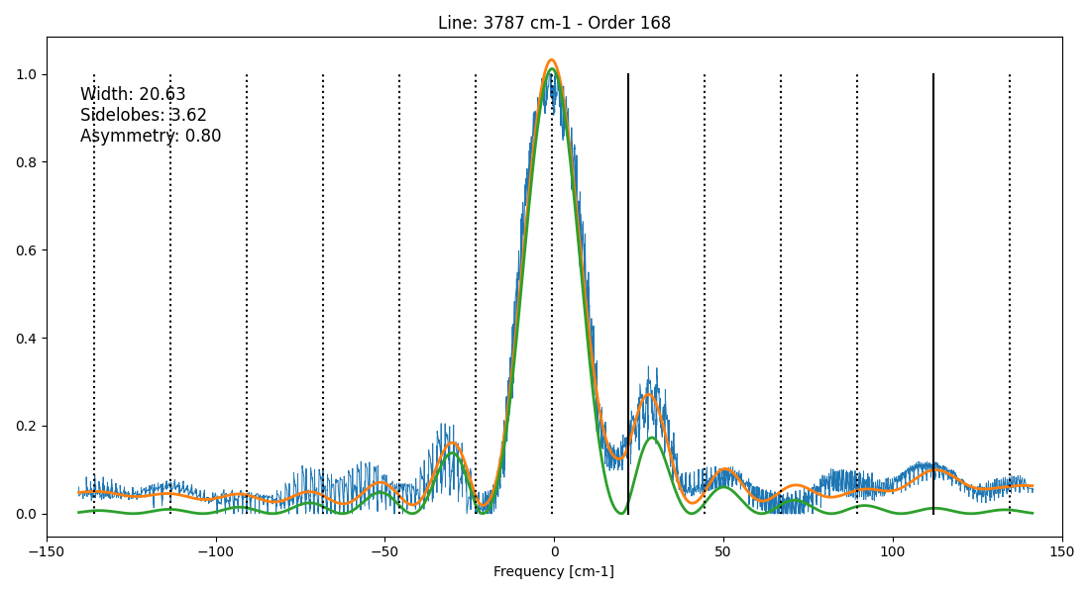

Slide 21


Slide 22
Determining a “recipe”

Slide 23
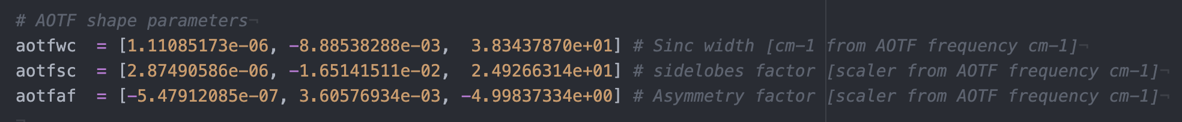
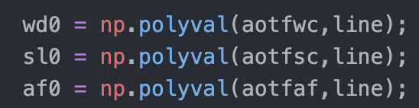
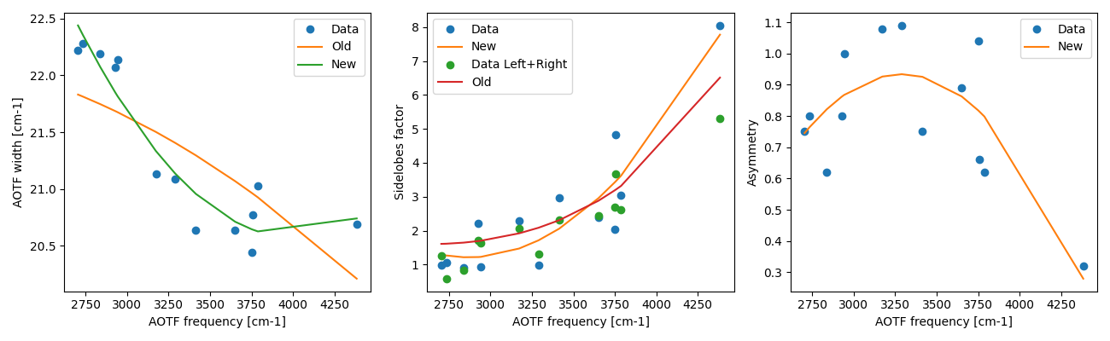

Slide 24
How many orders to include to achieve a certain SNR considering this new AOTF model?
Study for altitudes: 5, 25, 50, 100 km
Orders:
121: HDO/CO₂
134: H₂O/CH₄
148: CO₂
168/169: H₂O/CO₂
191: CO

Slide 25
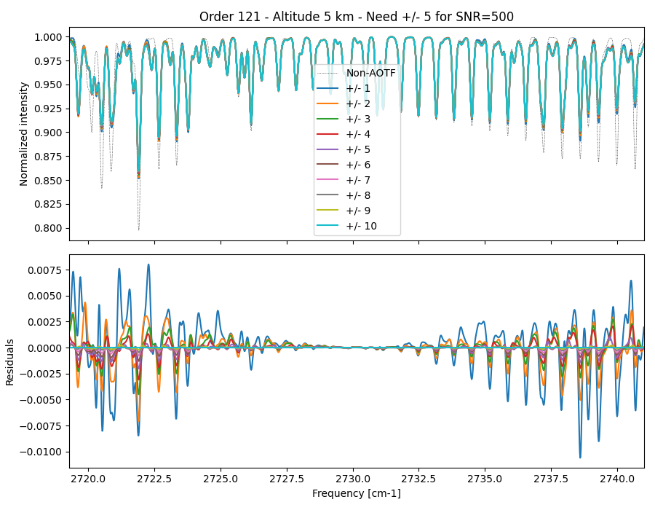

Slide 26
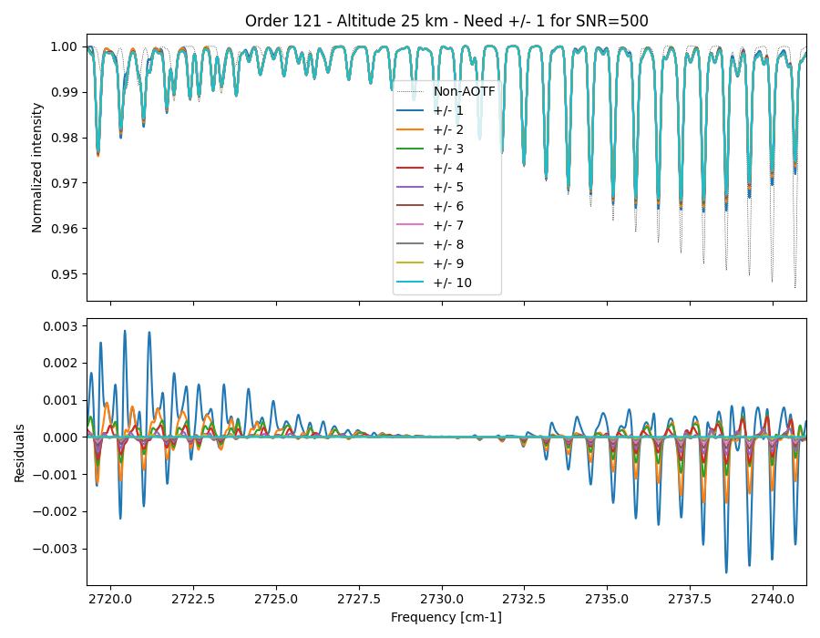

Slide 27
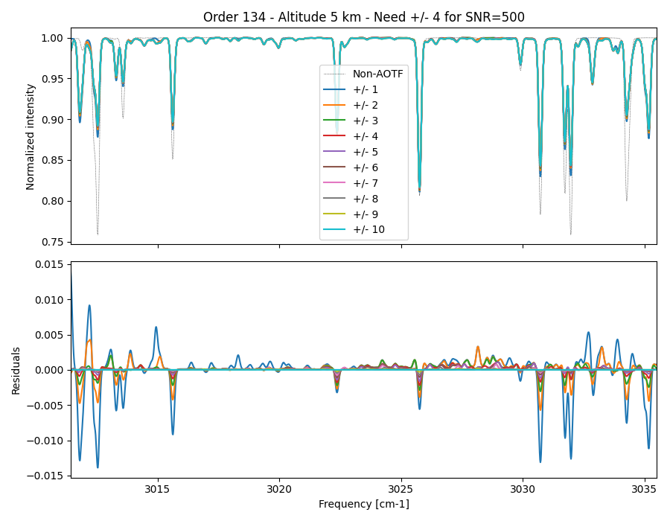

Slide 28
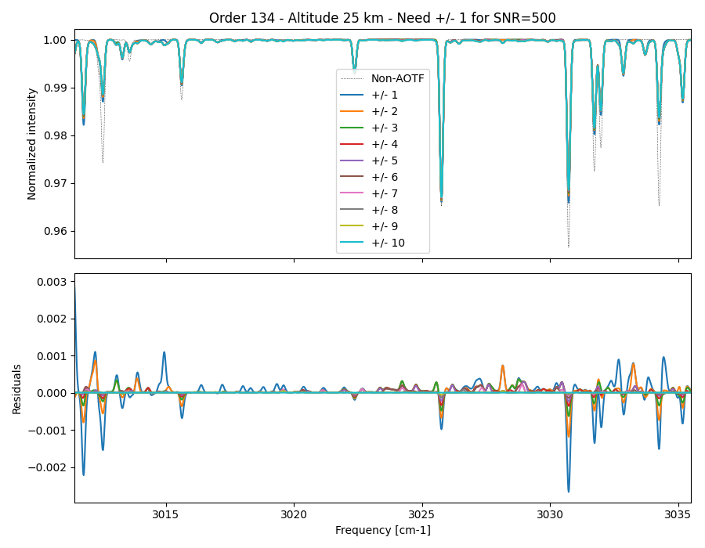

Slide 29
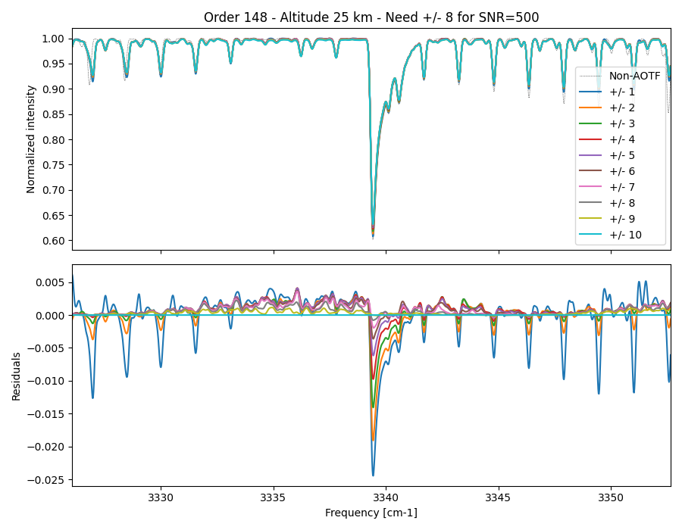

Slide 30
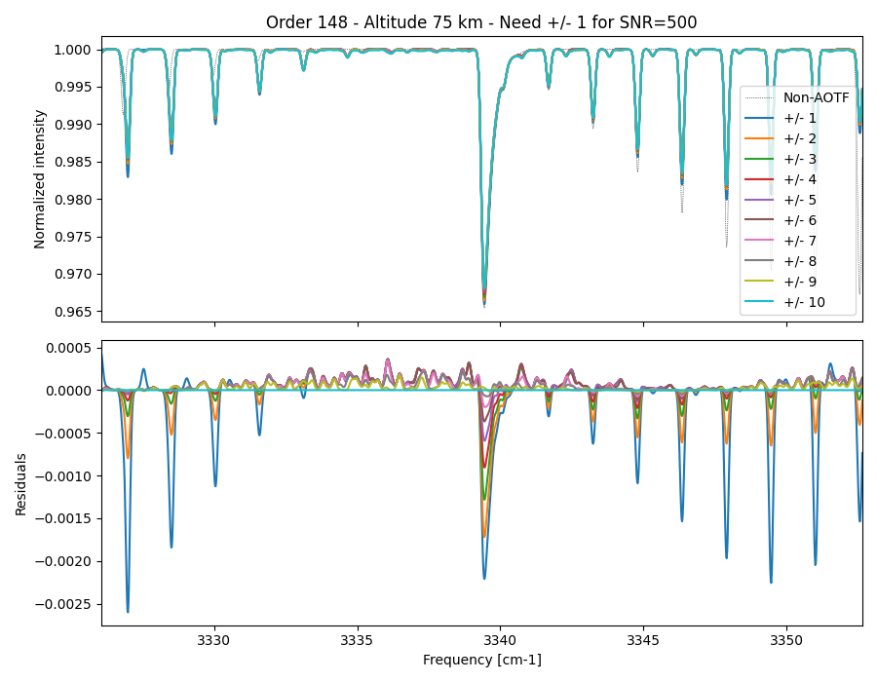

Slide 31
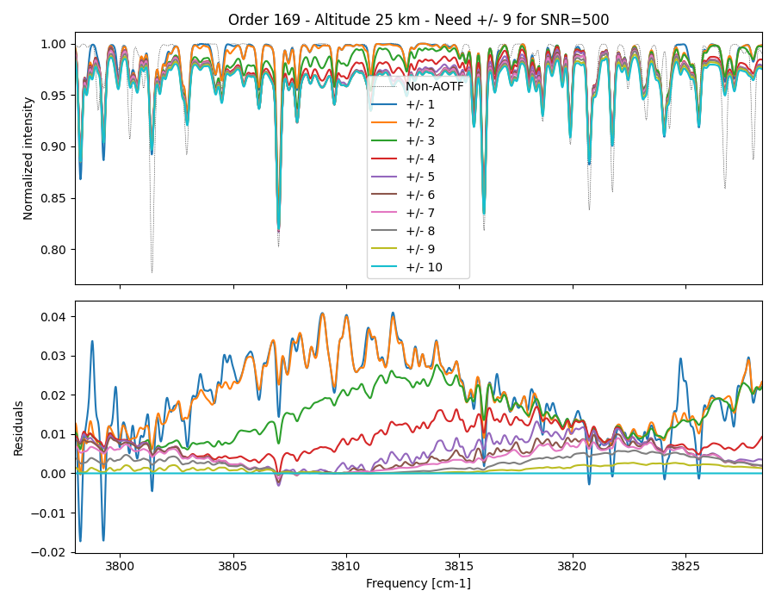

Slide 32
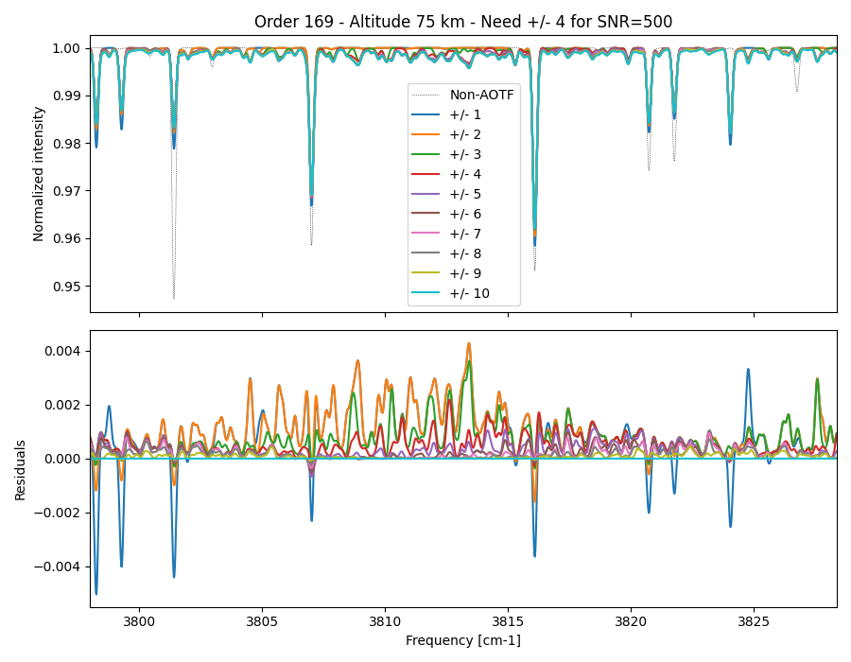

Slide 33
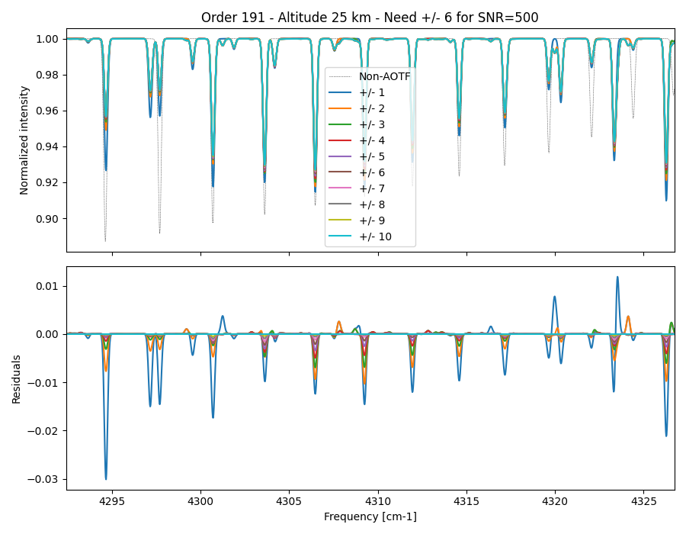

Slide 34
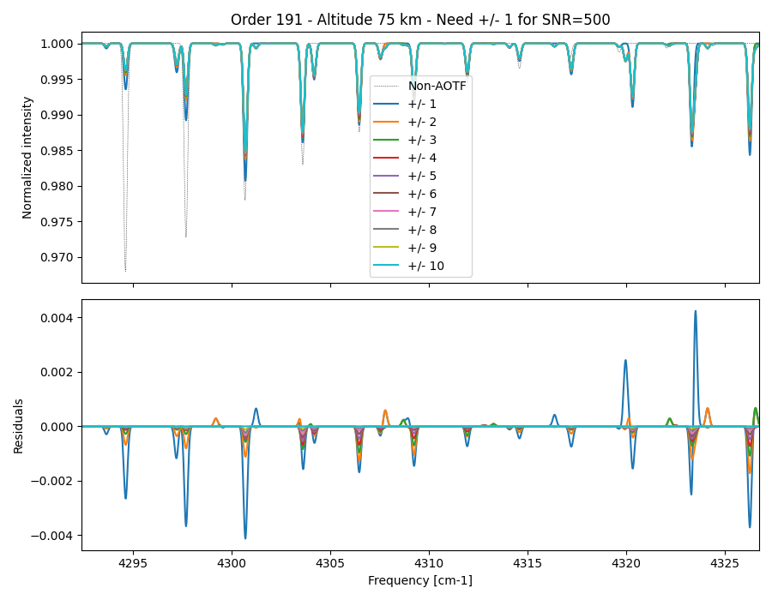

Slide 35
Preliminary conclusions
The miniscans data can be mostly described with a single asymmetric sinc
A new global “recipe” has been determined.
Information about a systematic “offset” is not possible to derive from the solar mini-scans and an independent study on the Mars data is needed. We are exploring full-scans and several orders in order to accurately quantify this extended AOTF response.
All codes and documentation for this study are available at: https://github.com/nasapsg/ExoMars

